Slide 1
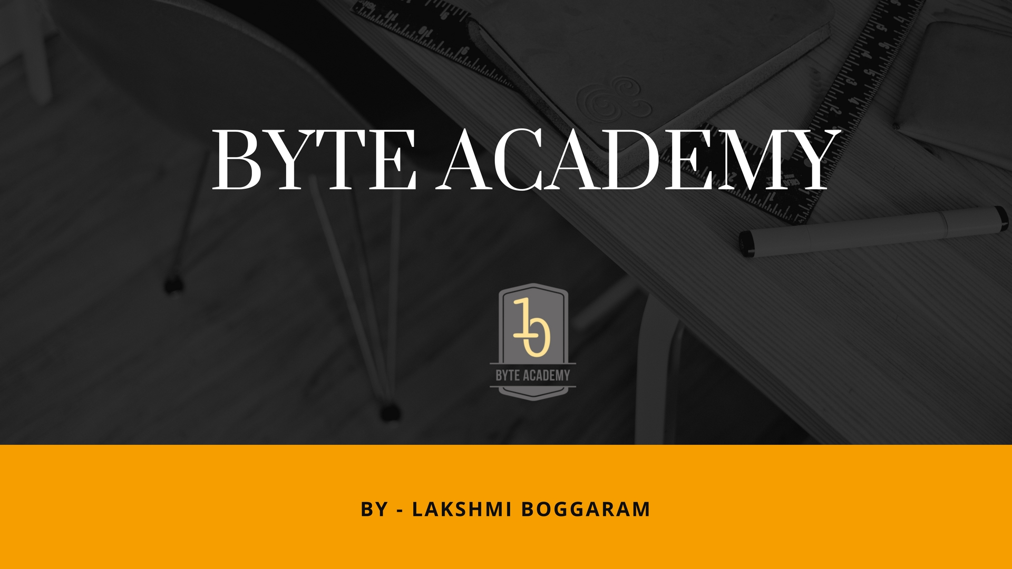

Slide 2

Python Data Model

Slide 3

Python Objects, Values and Types
Objects
Objects are python’s abstraction of data. All data in python are represented by objects or relation between objects..
Each object has an identity, type and value.
Identity – An object’s identity never changes once it have been created. It is nothing but the object’s address in memory.
The ‘is’ operator compares the identify of two objects.
The id() function returns an integer representing its identity. Id(x) is the memory address of x where x is stored
Values
Values are the data the objects store in memory.
The values of some objects can change. Objects whose values can be changed are said to be ‘mutable’, whose value is unchangeable once they are created are called ‘immutable’
An object’s mutability is determined by its type.
Types
An object’s type determines the operations that objects supports
It defines the possible values for objects of that type
type() function returns an object’s type

Slide 4
Python Object Types Hierarchy
None
NotImplemented
Ellipsis
Numbers
Sequences
Set Types
Mappings
I/O Objects
Callable types
Modules
Classes
Internal Types

Slide 5
Callable Types
User Defined Functions
Built In Functions
Built in Methods
Classes
Instance Methods
Class Instances
Generator Functions
Co routine Functions
Asynchronous Generator Functions

Slide 6


